Slide 1


Artificial Intelligence
Local Search

Slide 2
Classical Search
Designed to explore search spaces systematically
Systematicity is achieved by keeping one or more paths in memory and by recording which alternatives have been explored at each point along the path
When a goal is found, the path to that goal constitutes a solution to the problem
Observable, deterministic, known environments where the solution is a sequence of actions

Slide 3
Local Search
Evaluates and modifies one or more current states rather than systematically exploring paths from an initial state
Not systematic
Suitable for solving
problems in which all that matters is the solution state, not the path cost to reach it, e.g., 8 Queen problem
pure optimization problems, in which the aim is to find the best state according to an objective, the path to the goal does not matter
e.g., nature provides an objective function—reproductive fitness—that Darwinian evolution could be seen as attempting to optimize, but there is no “goal test” and no “path cost” for this problem

Slide 4
Local Search
Operates using a single current node (rather than multiple paths) and generally move only to neighbors of that node. Typically, the paths followed by the search are not retained.
Advantages
use very little memory—usually a constant amount
can often find reasonable solutions in large or infinite (continuous) state spaces for which systematic algorithms are unsuitable

Slide 5
Local Search Algorithms
Hill-climbing
Simulated annealing (inspired by statistical physics)
Beam Search
Genetic algorithms (inspired by evolutionary biology)

Slide 6
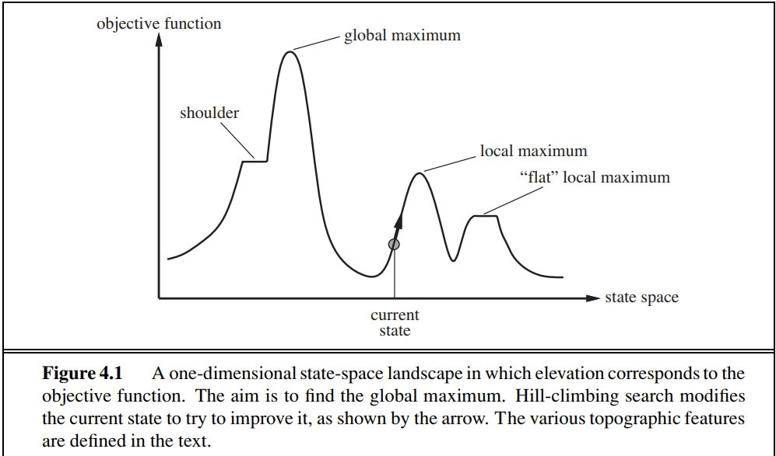
State-space landscape
Location - defined by the state
Elevation – defined by the value of the heuristic cost function or objective function
If elevation corresponds to cost, then the aim is to find the lowest valley—a global minimum
if elevation corresponds to an objective function, then the aim is to find the highest peak—a global maximum
You can convert from one to the other just by inserting a minus sign.
A complete local search algorithm always finds a goal if one exists
An optimal algorithm always finds a global minimum/maximum

Slide 7
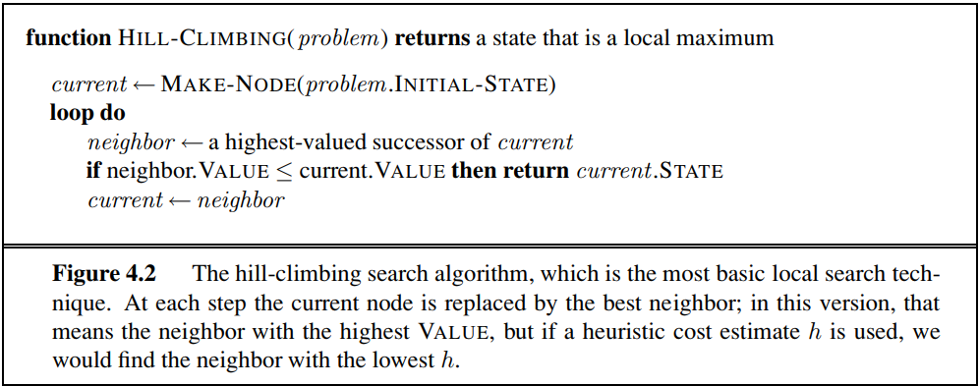
Hill-climbing search

Slide 8
Hill-climbing search Steepest-ascent version
It is simply a loop that continually moves in the direction of increasing value—that is, uphill
It terminates when it reaches a peak where no neighbor has a higher value
It does not maintain a search tree, so the data structure for the current node need only record the state and the value of the objective function

Slide 9
Hill-climbing search
Does not look ahead beyond the immediate neighbors of the current state. This resembles trying to find the top of Mount Everest in a thick fog while suffering from amnesia.
Sometimes called greedy local search because it grabs a good neighbor state without thinking ahead about where to go next

Slide 10
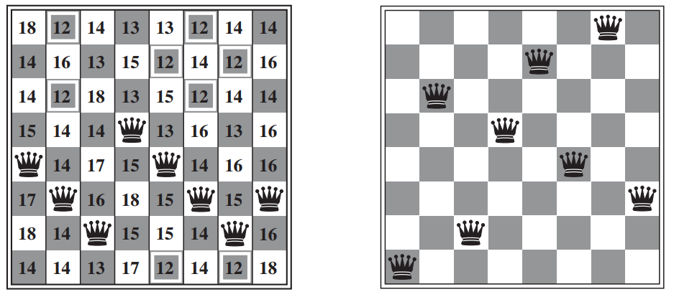
Hill-climbing search Example: 8-queens problem
h = 17
h = 1
Typically uses a complete-state formulation, where each state has 8 queens on the board, one per column
The successors of a state are all possible states generated by moving a single queen to another square in the same column
each state has 8x7=56 successors
The heuristic cost function h is the number of pairs of queens that are attacking each other, either directly or indirectly
The global minimum of this function is zero, which occurs only at perfect solutions

Slide 11
Hill-climbing search Steepest-ascent version
Unfortunately, it often gets stuck for the following reasons:
Local maxima
Ridges
Plateaux
In each case, the algorithm reaches a point at which no progress is being made

Slide 12
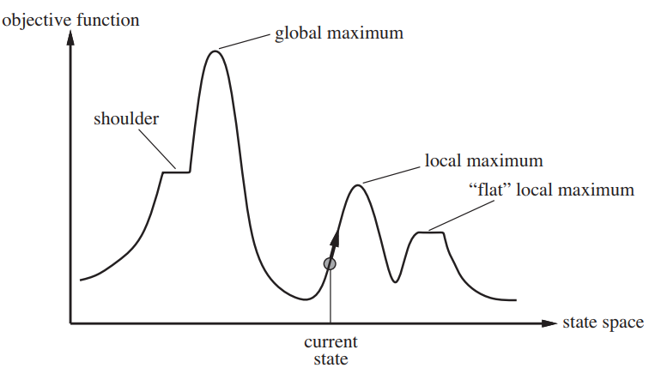
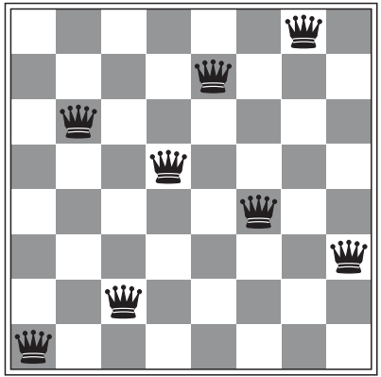
Hill-climbing search Steepest-ascent version
Unfortunately, it often gets stuck for the following reasons:
Local maxima - a peak that is higher than each of its neighboring states but lower than the global maximum
Hill-climbing algorithms that reach the vicinity of a local maximum will be drawn upward toward the peak but will then be stuck with nowhere else to go
Ridges
Plateaux
A local maxima; Every move of a single queen makes the situation worse

Slide 13
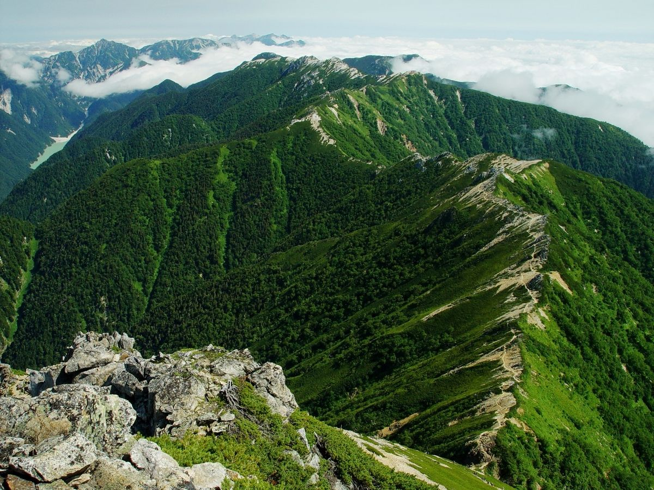
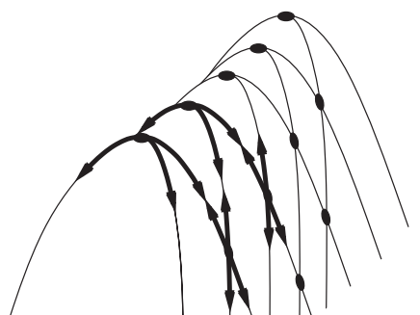
Hill-climbing search Steepest-ascent version
Unfortunately, it often gets stuck for the following reasons:
Local maxima
Ridges
A ridge or a mountain ridge is a geographical feature consisting of a chain of mountains or hills that form a continuous elevated crest for some distance. The sides of the ridge slope away from narrow top on either side
Ridges result in a sequence of local maxima that is very difficult for greedy algorithms to navigate
Plateaux

Slide 14
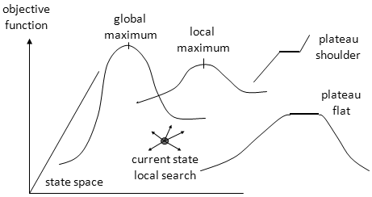
Hill-climbing search Steepest-ascent version
Unfortunately, it often gets stuck for the following reasons:
Local maxima
Ridges
Plateaux - is a flat area of the state-space landscape
It can be a flat local maximum, from which no uphill exit exists, or a shoulder, from which progress is possible

Slide 15
Hill-climbing search Steepest-ascent version
Starting from a randomly generated 8-queens state, steepest-ascent hill climbing gets stuck 86% of the time, solving only 14% of problem instances.
It works quickly, taking just 4 steps on average when it succeeds and 3 when it gets stuck—not bad for a state space with 8^8 ≈ 17 million states
Hill-climbing halts if it reaches a plateau where the best successor has the same value as the current state
How about allowing sideway moves in the hope that the plateau is really a shoulder?

Slide 16
Hill-climbing search Steepest-ascent version
How about allowing sideway moves?
Good, but be cautious
If we always allow sideways moves when there are no uphill moves, an infinite loop will occur whenever the algorithm reaches a flat local maximum that is not a shoulder.
One common solution is to put a limit on the number of consecutive sideways moves allowed.
If we allow 100 consecutive sideways moves in the 8-queens problem, the success rate increases from 14% to 94%.
Success comes at a cost: the algorithm averages roughly 21 steps for each successful instance and 64 for each failure.

Slide 17
Hill-climbing search Variants
Steepest-ascent version (incomplete)
Stochastic hill climbing (incomplete)
First-choice hill climbing (incomplete)
Random-restart hill climbing (trivially complete)

Slide 18
Hill-climbing variants
Steepest-ascent version
Stochastic hill climbing
Chooses at random from among the uphill moves; the probability of selection can vary with the steepness of the uphill move.
Usually converges more slowly than steepest ascent, but in some state landscapes, it finds better solutions.
First-choice hill climbing
Random-restart hill climbing

Slide 19
Hill-climbing variants
Steepest-ascent version
Stochastic hill climbing
First-choice hill climbing
Implements stochastic hill climbing by generating successors randomly until one is generated that is better than the current state.
This is a good strategy when a state has many (e.g., thousands) of successors.
Random-restart hill climbing

Slide 20
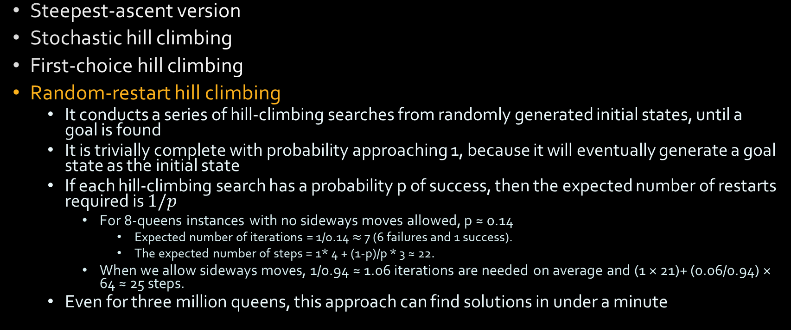
Hill-climbing variants

Slide 21
Hill-climbing
The success of hill climbing depends very much on the shape of the state-space landscape:
if there are few local maxima and plateaux, random-restart hill climbing will find a good solution very quickly.
However, many real problems have many local maxima, ridges and plateaux
NP-hard problems typically have an exponential number of local maxima to get stuck on.
Despite this, a reasonably good local maximum can often be found after a small number of restarts

Slide 22
6 Queen problem using Hill climbing (steepest ascent)
Heuristic: #of queen pairs attacking each other
Action: randomly choose a row and move the queen in that row 1 cell
state.VALUE: -#(of queen pairs attacking each other)
X
 | X
 |  |  |  | X
 |  |  | X
 | X
X

Slide 23
6 Queen problem using Hill climbing (steepest ascent)
Heuristic: #of queen pairs attacking each other
Action: randomly choose a row and move the queen in that row 1 cell
X
 | X
 |  |  |  | X
 |  |  | X
 | X
X
3+2+1+0+1+0=7
X
 | X
 |  |  | X
 |  |  | X
 | X
X
X
 | X
 |  |  |  |  | X
 |  |  | X
 | X
X
 | X
 | X
 |  |  |  |  | X
 |  |  | X
 | X
X
3+2+3+0+1+0=9
3+2+0+0+1+0=6
2+2+0+0+1+0=4

Slide 25
Simulated annealing

Slide 26
Simulated annealing
A hill-climbing algorithm that never makes “downhill” moves toward states with lower value (or higher cost) is guaranteed to be incomplete, because it can get stuck on a local maximum
In contrast, a purely random walk—that is, moving to a successor chosen uniformly at random from the set of successors—is complete but extremely inefficient.
Therefore, it seems reasonable to try to combine hill climbing with a random walk in some way that yields both efficiency and completeness. Simulated annealing is such an algorithm.

Slide 27
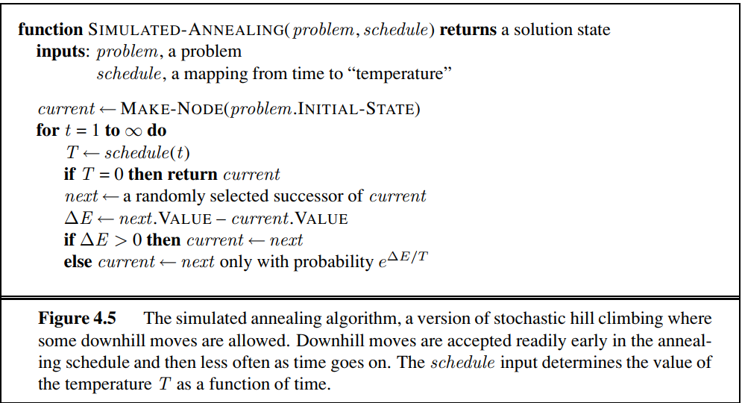
Simulated annealing

Slide 28
Simulated annealing
Gradient descent - minimizing cost
Intuition:
Imagine the task of getting a ping-pong ball into the deepest crevice in a bumpy surface. If we just let the ball roll, it will come to rest at a local minimum. If we shake the surface, we can bounce the ball out of the local minimum. The trick is to shake just hard enough to bounce the ball out of local minima but not hard enough to dislodge it from the global minimum. The simulated-annealing solution is to start by shaking hard (i.e., at a high temperature) and then gradually reduce the intensity of the shaking (i.e., lower the temperature)

Slide 29
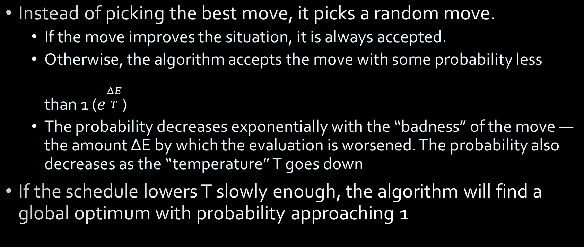
Simulated annealing

Slide 30
Simulated annealing Applications
Simulated annealing was first used extensively to solve VLSI layout problems in the early 1980s. It has been applied widely to factory scheduling and other large-scale optimization tasks.

Slide 31
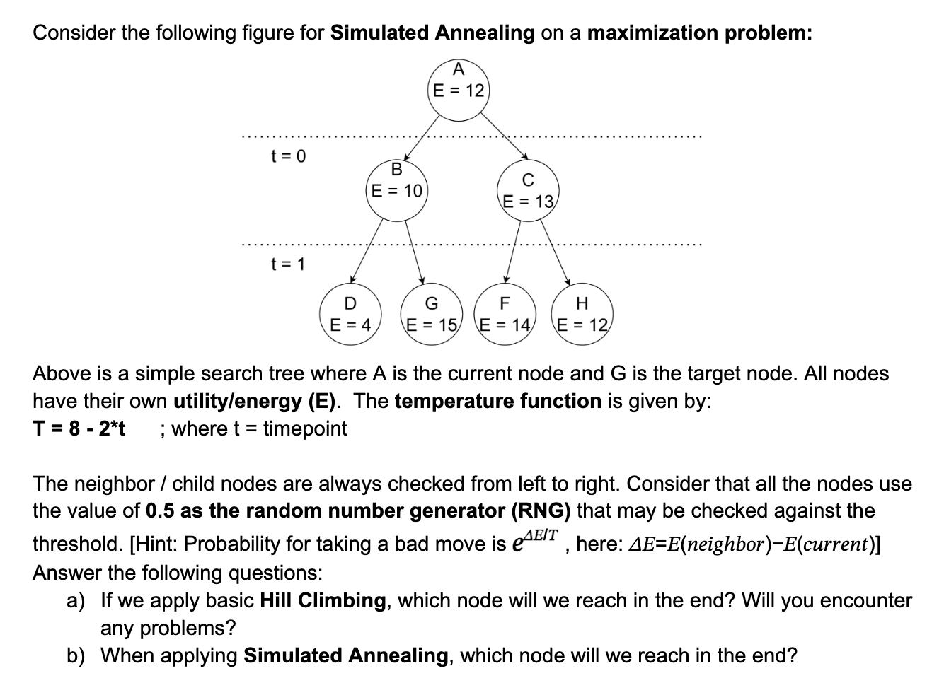

Slide 32
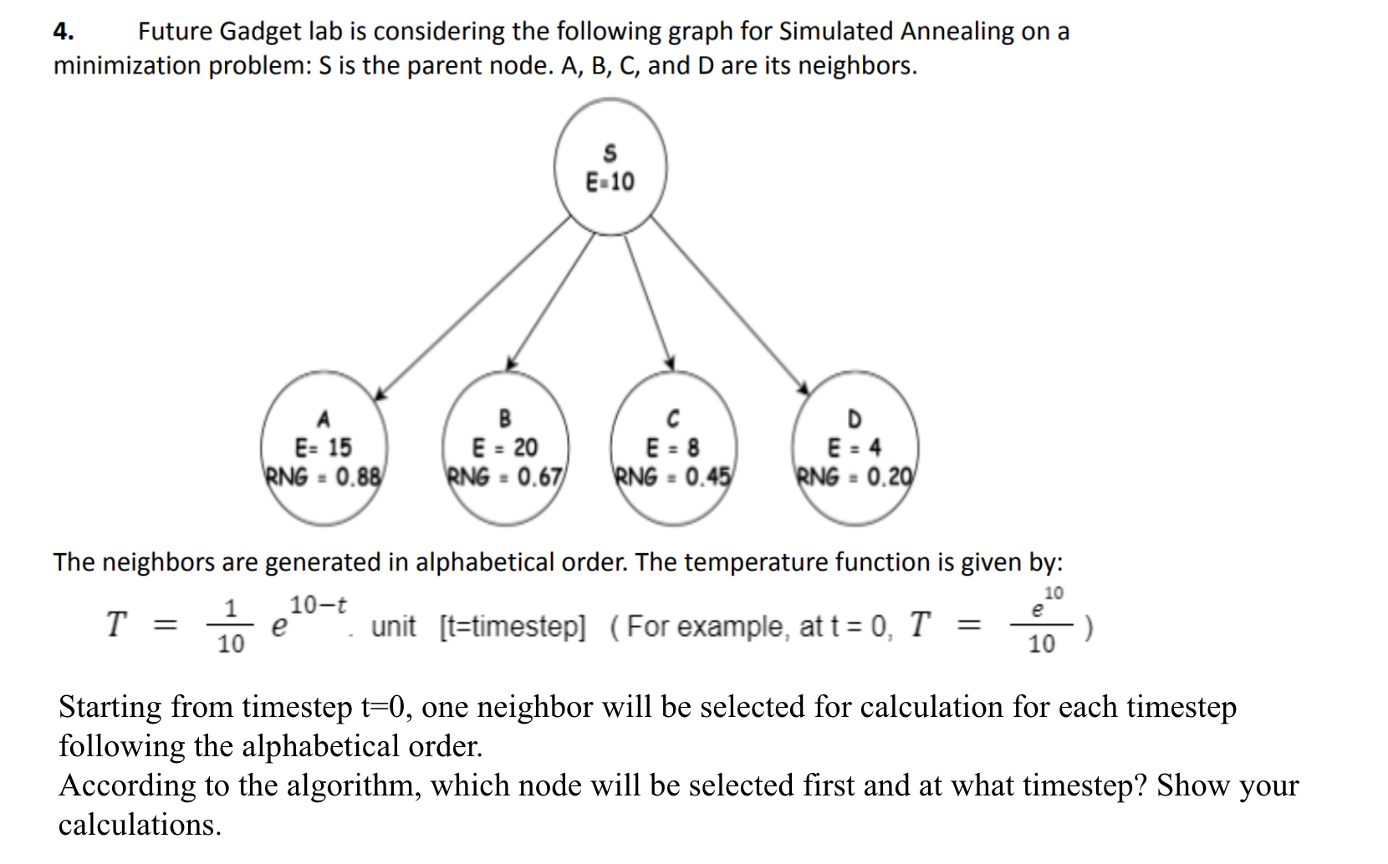

Slide 33
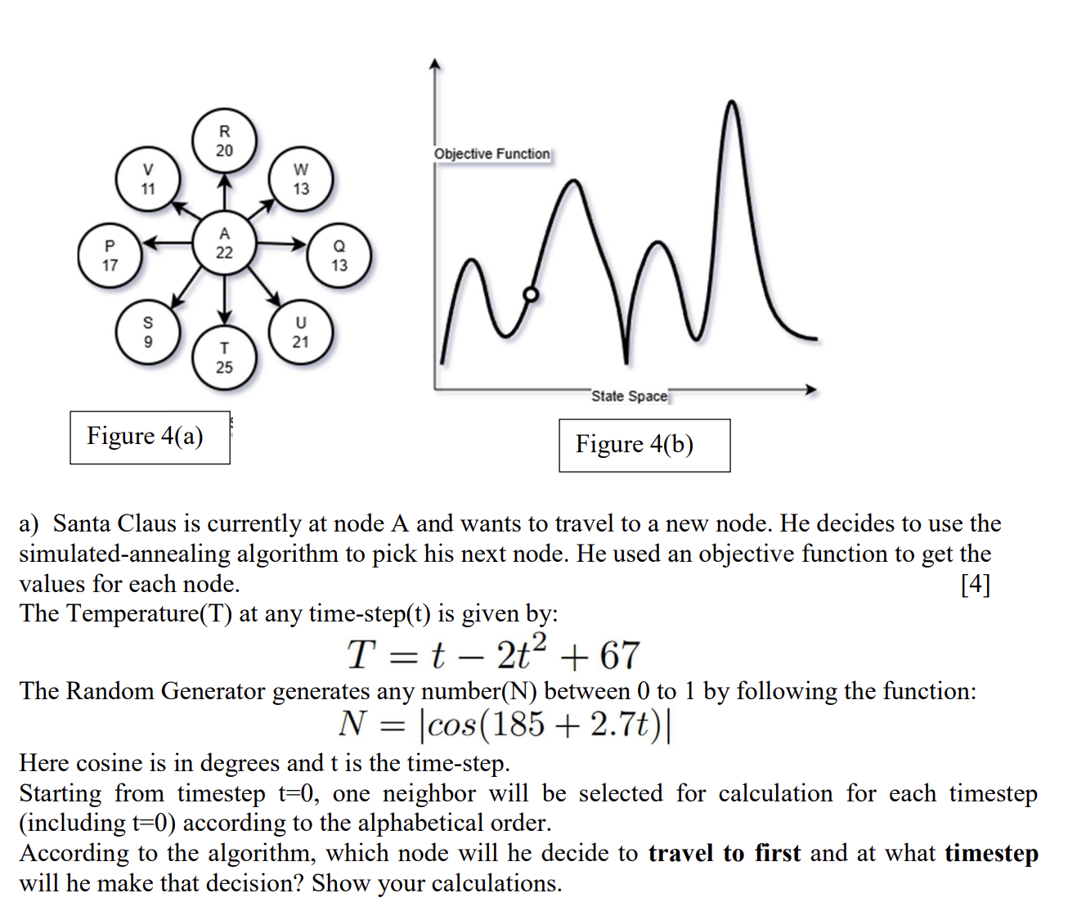

Slide 34
Beam search

Slide 35
Local beam search
keeps track of k states rather than just one
It begins with k randomly generated states.
At each step, all the successors of all k states are generated. If any one is a goal, the algorithm halts. Otherwise, it selects the k best successors from the complete list and repeats.
useful information is passed among the parallel k search threads
quickly abandons unfruitful searches and moves its resources to where the most progress is being made
not like random restart with k restarts
can suffer from a lack of diversity among the k states
they can quickly become concentrated in a small region of the state space, making the search little more than an expensive version of hill climbing

Slide 36
Stochastic beam search
Instead of choosing the best k from the pool of candidate successors, stochastic beam search chooses k successors at random, with the probability of choosing a given successor being an increasing function of its value
Stochastic beam search bears some resemblance to the process of natural selection, whereby the “successors” (offspring) of a “state” (organism) populate the next generation according to its “value” (fitness)

Slide 37
Genetic algorithms

Slide 38
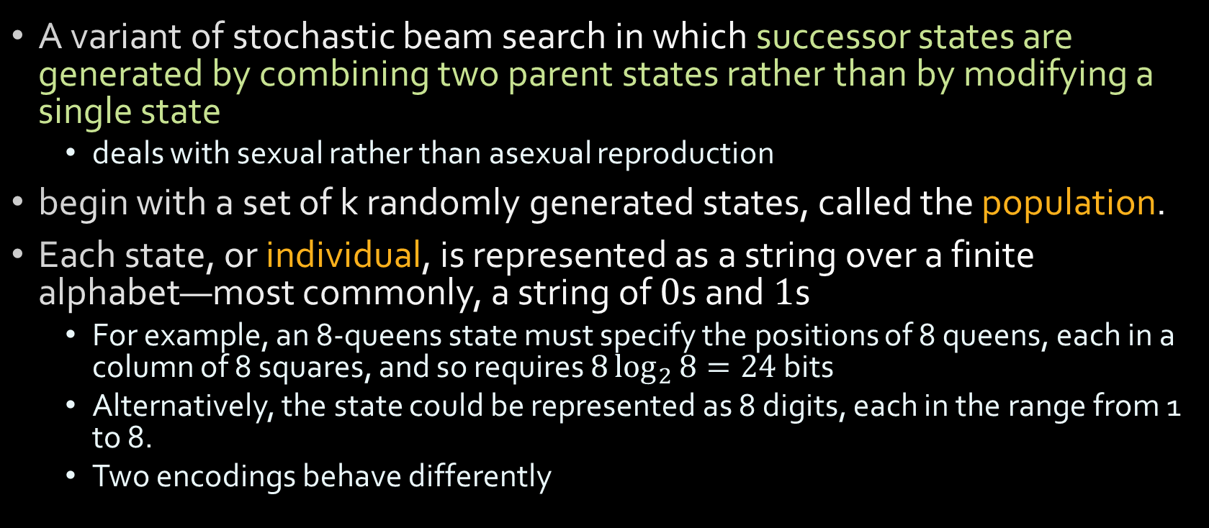
Genetic algorithms (GA)

Slide 39
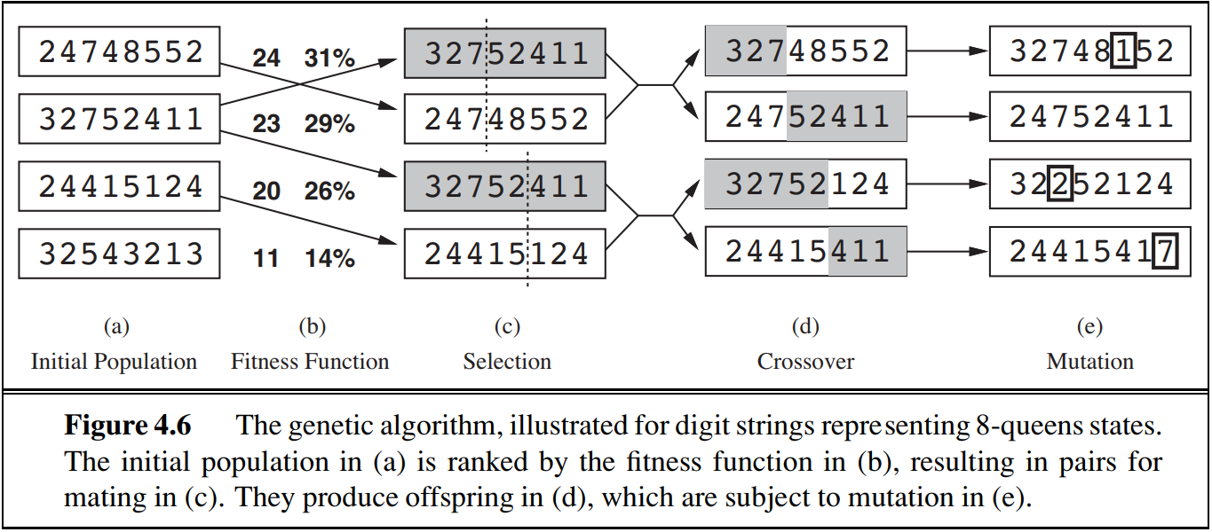
Genetic algorithms
production of the next generation of states

Slide 40
Genetic algorithms
each state is rated by the objective function called the fitness function.
A fitness function should return higher values for better states
for the 8-queens problem we use the number of non attacking pairs of queens, which has a value of 28 for a solution.
In this particular variant of the genetic algorithm, the probability of being chosen for reproducing is directly proportional to the fitness score, and the percentages are shown next to the raw scores

Slide 41
Genetic algorithms
two pairs are selected at random for reproduction, in accordance with the probabilities in (b).
Notice that one individual is selected twice and one not at all.4
There are many variants of this selection rule. The method of culling, in which all individuals below a given threshold are discarded, can be shown to converge faster than the random version.

Slide 42
Genetic algorithms
For each pair to be mated, a crossover point is chosen randomly from the positions in the string.
Encoding matters here. If a 24-bit encoding is used instead of 8 digits, then the crossover point has a 2/3 chance of being in the middle of a digit, which results in an essentially arbitrary mutation of that digit.

Slide 43
Genetic algorithms
The offspring themselves are created by crossing over the parent strings at the crossover point.
It is often the case that the population is quite diverse early on in the process, so crossover (like simulated annealing) frequently takes large steps in the state space early in the search process and smaller steps later on when most individuals are quite similar

Slide 44
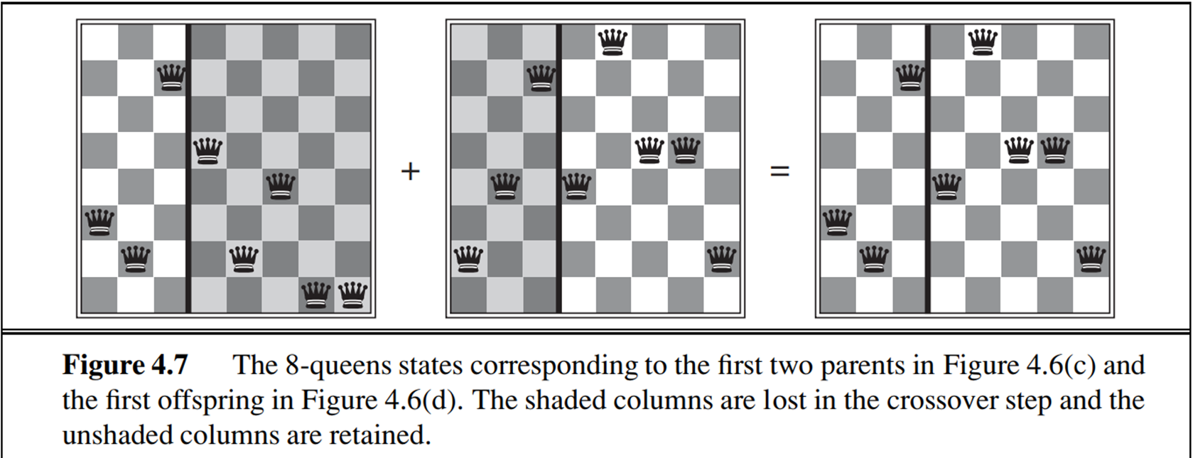
Genetic algorithms
The offspring themselves are created by crossing over the parent strings at the crossover point.
The 8-queens states involved in this reproduction step are shown in this figure

Slide 45
Genetic algorithms
Each location is subject to random mutation with a small independent probability.
In the 8-queens problem, this corresponds to choosing a queen at random and moving it to a random square in its column.

Slide 46
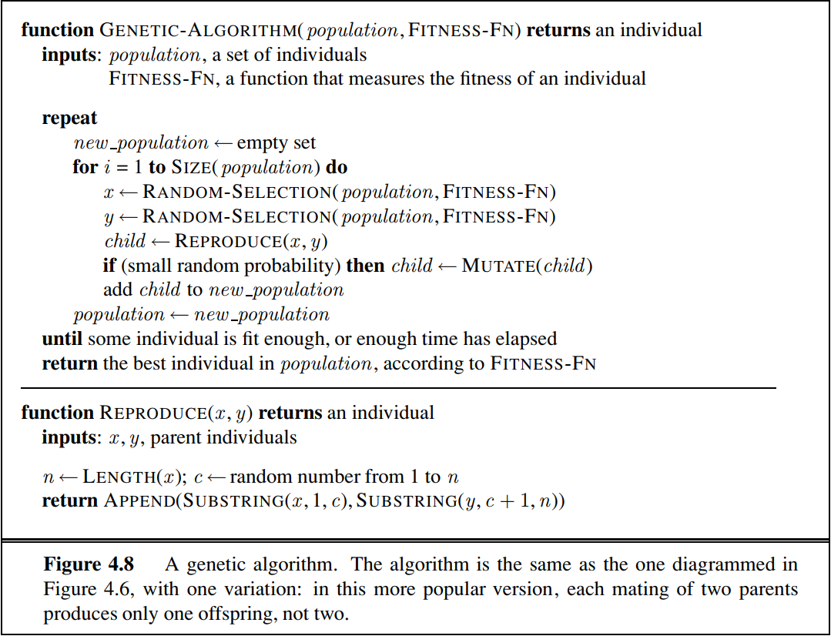
Genetic algorithms
Genetic algorithms

Slide 47
Genetic algorithms
Like stochastic beam search, genetic algorithms combine an uphill tendency with random exploration and exchange of information among parallel search threads.
The primary advantage, if any, of genetic algorithms comes from the crossover operation. Yet it can be shown mathematically that, if the positions of the genetic code are permuted initially in a random order, crossover conveys no advantage.
Intuitively, the advantage comes from the ability of crossover to combine large blocks of letters that have evolved independently to perform useful functions, thus raising the level of granularity at which the search operates.
For example, it could be that putting the first three queens in positions 2, 4, and 6 (where they do not attack each other) constitutes a useful block that can be combined with other blocks to construct a solution

Slide 48
Genetic algorithms
The theory of genetic algorithms explains how this works using the idea of a schema, which is a substring in which some of the positions can be left unspecified.
For example, the schema 246***** describes all 8-queens states in which the first three queens are in positions 2, 4, and 6, respectively. Strings that match the schema (such as 24613578) are called instances of the schema. It can be shown that if the average fitness of the instances of a schema is above the mean, then the number of instances of the schema within the population will grow over time.
Clearly, this effect is unlikely to be significant if adjacent bits are totally unrelated to each other, because then there will be few contiguous blocks that provide a consistent benefit.
Genetic algorithms work best when schemata correspond to meaningful components of a solution.
For example, if the string is a representation of an antenna, then the schemata may represent components of the antenna, such as reflectors and deflectors. A good component is likely to be good in a variety of different designs. This suggests that successful use of genetic algorithms requires careful engineering of the representation.

Slide 49
Genetic algorithms
genetic algorithms have had a widespread impact on optimization problems, such as circuit layout and job-shop scheduling.
At present, it is not clear whether the appeal of genetic algorithms arises from their performance or from their æsthetically pleasing origins in the theory of evolution.
Much work remains to be done to identify the conditions under which genetic algorithms perform well.

Slide 50
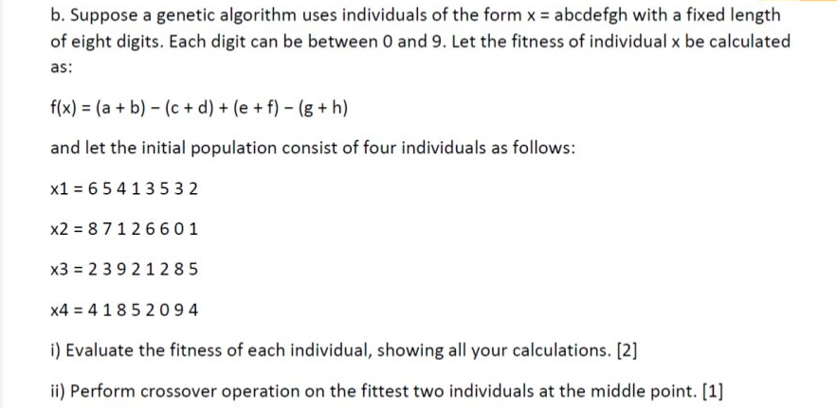

Slide 51
References
AIMA Chapter 4.1
Previous year questions

Slide 52
Some Excellent Resources!
2019 Berkeley CS 188 - Introduction to Artificial Intelligence
UC Berkeley CS 188 Introduction to Artificial Intelligence, Fall 2018
MIT 6.034 Artificial Intelligence, Fall 2010
Mohammad Imam Hossain https://www.slideshare.net/imamhossain75054/presentations/2

